Slide 1
DATA CENTER TECHNOLOGIES

Slide 2
What is Data Center?
A data center can be viewed as a facility (or facilities) whose duty is to manage a large amount of data.
A data center is logically composed of application software, software infrastructure (system software), and hardware infrastructure.

Slide 3
Hardware infrastructure indicates physical components such as servers, storage systems, network components, power supply, cooling system and anything needed to support data center operations
Software infrastructure refers to software running on hardware infrastructure, including low-level programs (e.g. OS) that interact with hardware.
It also offers many data center features to serve a large amount of data such as data protection, backup and virtualization.

Slide 4
Virtualization:
Data centers consist of both physical and virtualized IT resources. The physical IT resource layer refers to the facility infrastructure that houses computing/networking systems and equipment, together with hardware systems and their operating system.
The resource abstraction and control of the virtualization layer is comprised of operational and management tools that are often based on virtualization platforms that abstract the physical computing and networking IT resources as virtualized components that are easier to allocate, operate, release, monitor, and control.

Slide 5
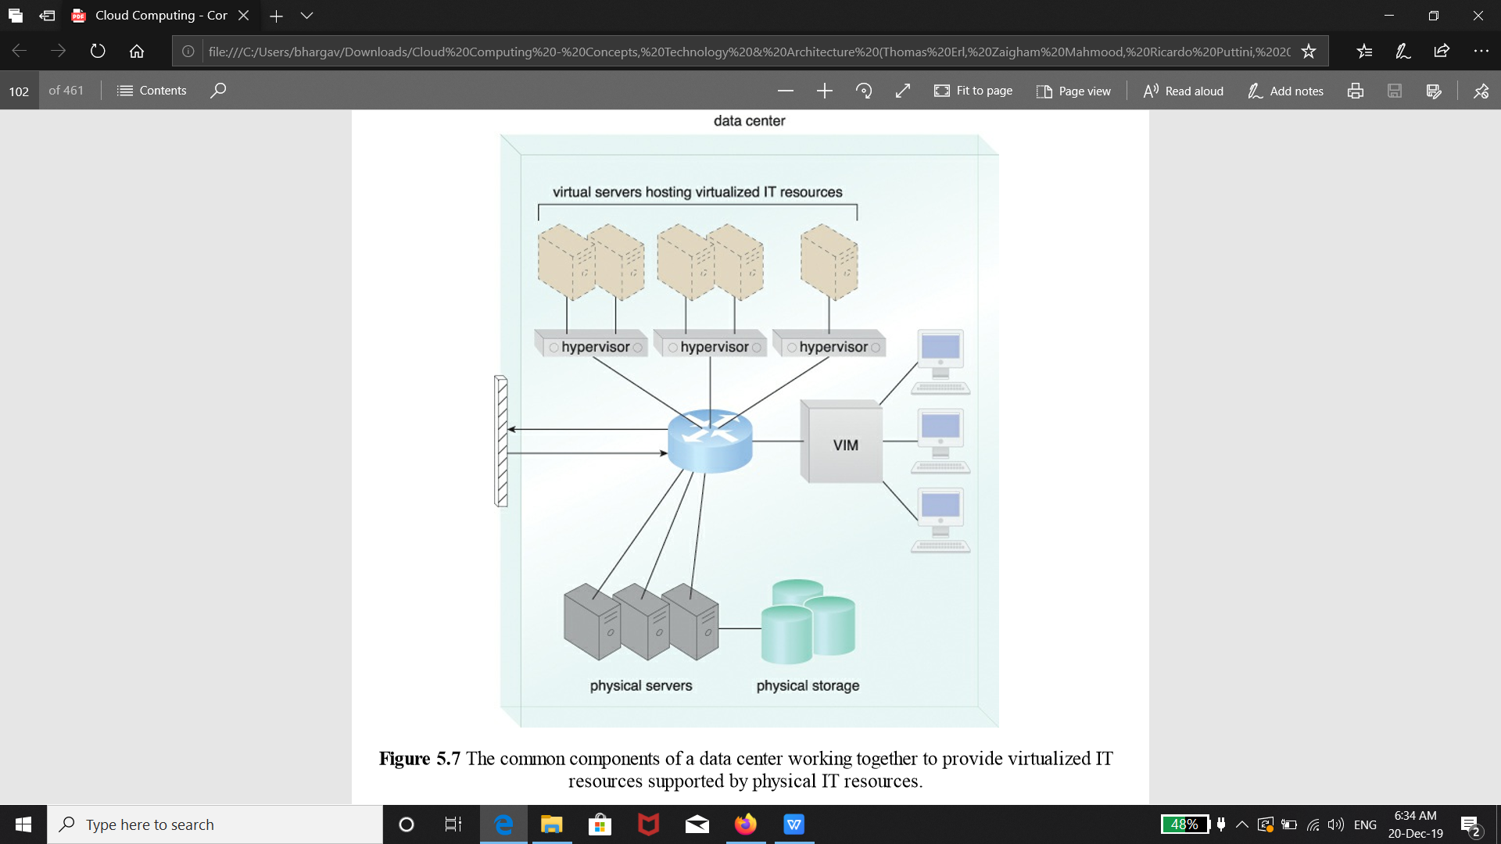

Slide 6
Standardization and Modularity: Data centers are built upon standardized commodity hardware and designed with modular architectures, aggregating multiple identical building blocks of facility infrastructure and equipment to support scalability, growth, and speedy hardware replacements.
Automation: Data centers have specialized platforms that automate tasks like provisioning, configuration, patching, and monitoring without supervision.
Remote Operation and Management: Most of the operational and administrative tasks of IT resources in data centers are commanded through the network’s remote consoles and management systems.

Slide 7
High Availability: Since any form of data center outage significantly impacts business continuity for the organizations that use their services, data centers are designed to operate with increasingly higher levels of redundancy to sustain availability.
Security-Aware Design, Operation, and Management: Requirements for security, such as physical and logical access controls and data recovery strategies, need to be thorough and comprehensive for data centers, since they are centralized structures that store and process business data.
Facilities: Data center facilities are custom-designed locations that are outfitted with specialized computing, storage, and network equipment.

Slide 8
Computer Hardware:
rackmount form factor server design composed of standardized racks with interconnects for power, network, and internal cooling
• support for different hardware processing architectures, such as x86-32bits, x86-64, and RISC
• a power-efficient multi-core CPU architecture that houses hundreds of processing cores in a space as small as a single unit of standardized racks
• redundant and hot-swappable components, such as hard disks, power supplies, network interfaces, and storage controller cards

Slide 9
Software Hardware:
Hard Disk Arrays
I/O Caching
Hot-Swappable Hard disks
Storage Virtualization
Fast Data Replication Mechanisms

Slide 10
Network Hardware: Data centers require extensive network hardware in order to enable multiple levels of connectivity.
Carrier and External Networks Interconnection: A subsystem related to the internetworking infrastructure, this interconnection is usually comprised of backbone routers that provide routing between external WAN connections and the data center’s LAN, as well as perimeter network security devices such as firewalls and VPN gateways.
Web-Tier Load Balancing and Acceleration: This subsystem comprises Web acceleration devices, such as XML pre-processors, encryption/decryption appliances, and layer 7 switching devices that perform content-aware routing.

Slide 11
LAN Fabric: The LAN fabric constitutes the internal LAN and provides high-performance and redundant connectivity for all of the data center’s network-enabled IT resources.
SAN Fabric: Related to the implementation of storage area networks (SANs) that provide connectivity between servers and storage systems, the SAN fabric is usually implemented with Fibre Channel (FC), Fibre Channel over Ethernet (FCoE), and InfiniBand network switches.
NAS Gateways: This subsystem supplies attachment points for NAS-based storage devices and implements protocol conversion hardware that facilitates data transmission between SAN and NAS devices.

